Slide 1
HMH Science Dimensions
Biology
Unit 9: Patterns of Evolution
Lesson 1: Evolution of Populations
Notes:
The learning experiences in this unit prepare students for the mastery of
Performance Expectations
LS1-2 Develop and use a model to illustrate the hierarchical organization of interacting systems that provide specific functions within multicellular organisms.
LS1-3 Plan and conduct an investigation to provide evidence that feedback mechanisms maintain homeostasis.
ETS1-2 Design a solution to a complex real-world problem by breaking it down into smaller, more manageable problems that can be solved through engineering.
ETS1-3 Evaluate a solution to a complex real-world problem based on prioritized criteria and trade-offs that account for a range of constraints, including cost, safety, reliability, and aesthetics, as well as possible social, cultural, and environmental impacts.

Slide 2

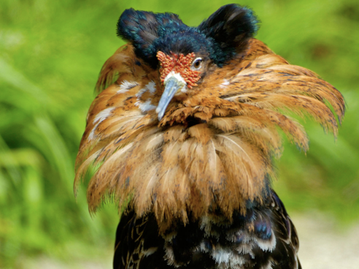
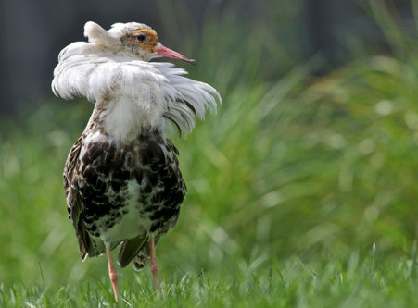
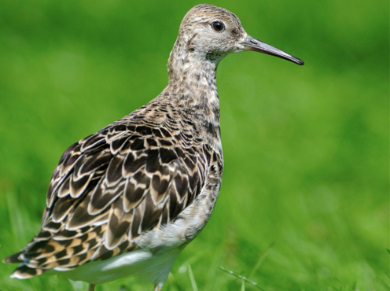
Can You Explain It?
Unit 9 Lesson 1
How can three different types of males evolve in one population?
Ruffs differ in body size as well as in the size and color of the feathers on their heads and necks.
Notes:
Lesson Objective
Explain the different mechanisms that cause populations to evolve.

Slide 3
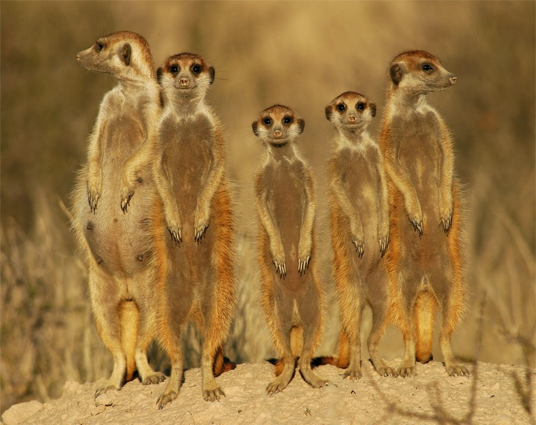
Genetic Variation
Unit 9 Lesson 1
Meerkats are mammals that live in the deserts of Africa. They live together in cooperative groups.
Record the similarities and differences you see between the meerkats. Why do traits vary between individuals in a population?
Meerkats stand alert to look for predators.

Slide 4
Genetic Variation
Unit 9 Lesson 1
The meerkats have variations in their physical traits, phenotypes. The phenotypic differences among the meerkats are due to differences in genes that code for those traits. Certain differences may offer a competitive advantage compared to the rest of the population.
A gene pool is the collection of alleles found in all the individuals of a population.
The different alleles in a gene pool result from mutations.
EXPLAIN
How can mutations in gametes become widespread in the gene pool?

Slide 5
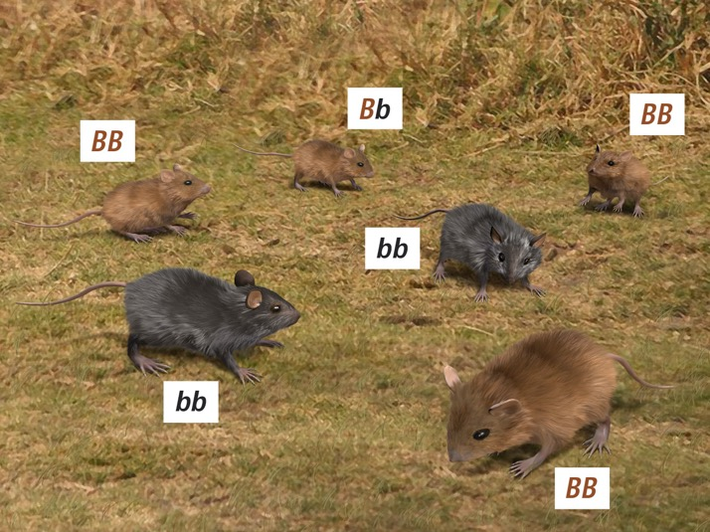
Genetic Variation
Unit 9 Lesson 1
Different combinations of alleles in a gene pool can be formed when organisms mate and have offspring.
Alleles are different forms, or versions, of genes.
For example, mice with either one or two copies of the dominant B allele have brown fur, while mice with two recessive b alleles have black fur.
Field Mice Alleles | Differences in fur color in mice are due to differences in allele combinations.

Slide 6

Genetic Variation
Unit 9 Lesson 1
You can use the total number of alleles, the number of dominant alleles, and the number of recessive alleles to find the allele frequency in a population.
Allele frequency is the proportion of one allele, compared with all the alleles for that trait, in the gene pool.
To find the frequency of a particular allele, divide the number of times the allele is present by the total number of alleles in the population.

Slide 7
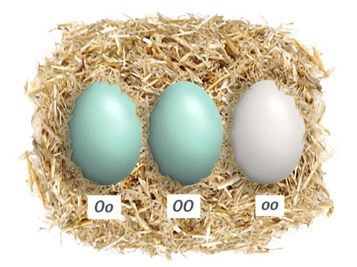
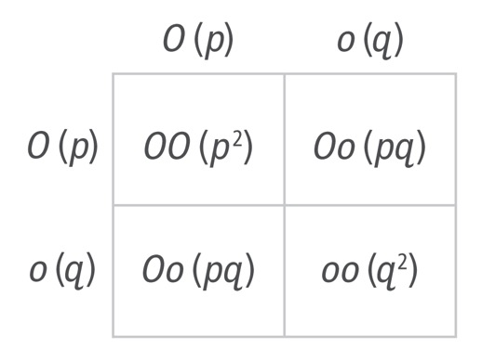
Genetic Variation
Unit 9 Lesson 1
The Punnett square is a square diagram that is used to predict the genotypes of a particular cross or breeding experiment
What could a scientist conclude if the genotypic frequencies in a population are different from the predicted values?
In some birds, blue eggshells are dominant to white eggshells.
In this Punnett square, p represents the dominant allele and q represents the recessive allele.

Slide 8
Genetic Variation Data Analysis
Unit 9 Lesson 1
In a population of 1000 chickens, 840 hens lay blue eggs and 160 hens lay white eggs. Use the equation p² + 2pq + q² = 1 to determine the predicted genotypic frequencies for this population. Then compare those values with the actual genotypic frequencies in the population.
Variables
p = frequency of O (dominant allele, blue shell)
q = frequency of o (recessive allele, white shell)
p² = frequency of chickens with OO (homozygous dominant genotype)
2pq = frequency of chickens Oo (heterozygous genotype)
q² = frequency of chickens with oo (homozygous recessive genotype)
Through genetic analysis, scientists discovered the actual genotypic frequencies for the above population to be OO = 0.60, Oo = 0.14, and oo = 0.26. What can you infer by comparing these data to the values predicted above?

Slide 9
Genetic Variation Cause and Effect
Unit 9 Lesson 1
The peppered moth, ranges in color from light to dark.
Before the Industrial Revolution, light moths were more prevalent than dark moths.
Over time, scientists observed that the number of dark moths increased relative to light moths.
Recent studies found bird predation was one possible driving force behind the population shift.

Slide 10
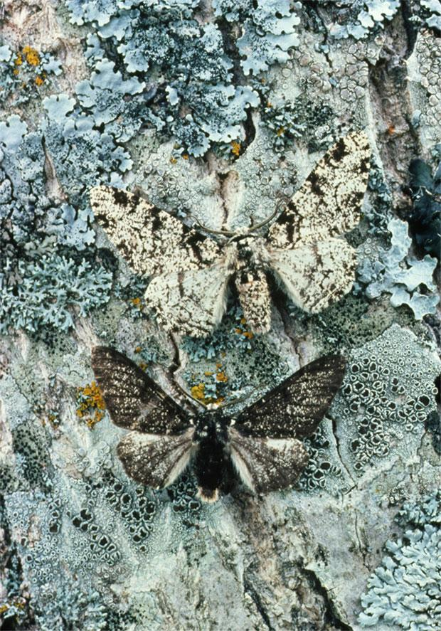
Genetic Variation Cause and Effect
Unit 9 Lesson 1
ANALYZE
Make a graph of the shift observed in the peppered moth population. Place the color range on the x-axis and frequency of the trait on the y-axis.
EXPLAIN
How does the Hardy-Weinberg equilibrium equation use genetic variation and allele frequencies in a population to describe whether a population is evolving?
The two variations of the peppered moth, Biston betularia. One variety is light (typica) and the other is dark (carbonaria).

Slide 11
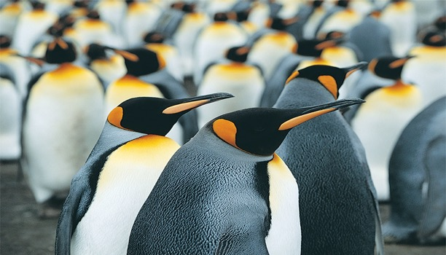
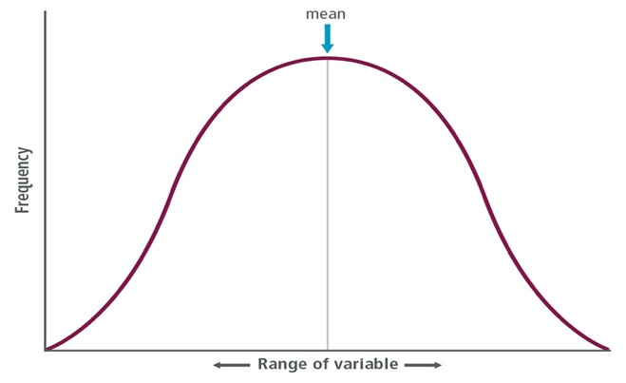
Selection on Populations
Unit 9 Lesson 1
Members of the King Penguin population differ in their physical traits - some may have either long or short beaks.
If penguin beak lengths and their frequencies are graphed, the result is a bell-shaped curve like the one shown in the Normal Distribution graph.
A normal distribution shows an arrangement of data in which most of the values fall in the middle of the data set, represented by the mean.
King Penguins
Most individuals in this population have traits that fall between two extreme phenotypes.

Slide 12
Unit 9 Lesson 1
Selection on Populations
King penguins live and breed on islands around Antarctica. Like other penguin species that live in cold areas, king penguins have features that allow them to live in this type of environment. They have layers of feathers as well as thick layers of fat to help keep them warm. Suppose the climate in this area warms up and continues to warm. How might this continuing change in temperature affect the population?
COLLABORATE
Suppose as a result of increasing temperatures, the trait for having a thick layer of fat was selected against and the thinner layer of fat was selected for. With a partner, discuss how the normal distribution graph will be affected.

Slide 13
Unit 9 Lesson 1
Selection on Populations
Natural selection favors phenotypes that allow individuals in the population to adapt to their environment and selects against phenotypes that make individuals less able to adapt to their environment. This "favoring" and "selecting against" result in observable changes in the allele frequencies in a population.
Microevolution is the observable change in the allele frequencies of a population over time. Microevolution occurs on a small scale—within a single population.
Stabilizing selection is the type of natural selection in which intermediate phenotypes are selected over phenotypes at both extremes.

Slide 14
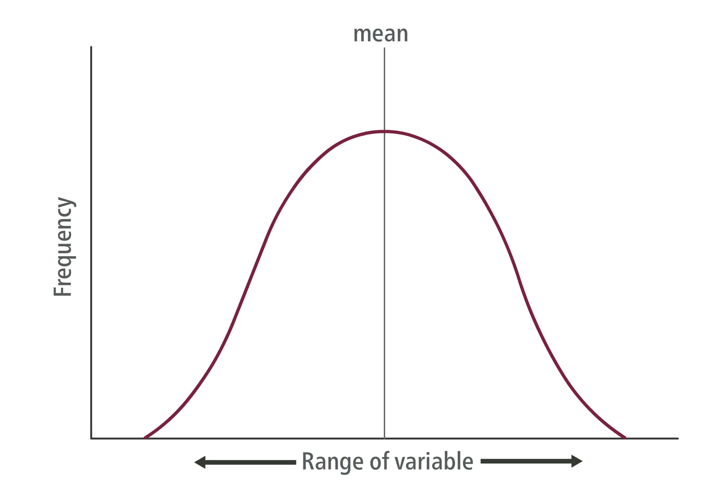
Unit 9 Lesson 1
Selection on Populations
Stabilizing selection is the type of natural selection in which intermediate phenotypes are selected over phenotypes at both extremes.
Observe how stabilizing selection affects the frequency of traits in a population.

Slide 15
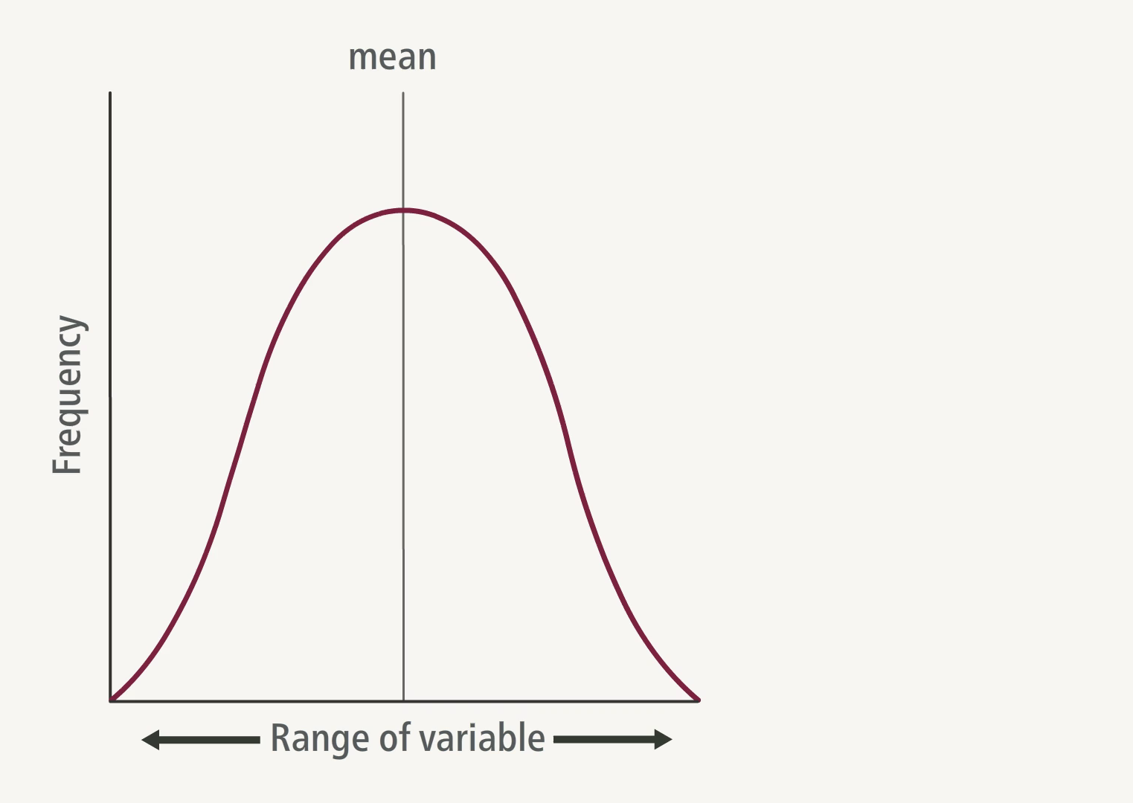
Unit 9 Lesson 1
Selection on Populations
Directional selection is the type of natural selection in which one extreme phenotype is selected over the other extreme phenotype, shifting the mean toward one of the extremes.
In the case of the peppered moths, the dark phenotype was selected over the light phenotype during the Industrial Revolution.
Observe how directional selection affects the frequency of traits in a population.

Slide 16
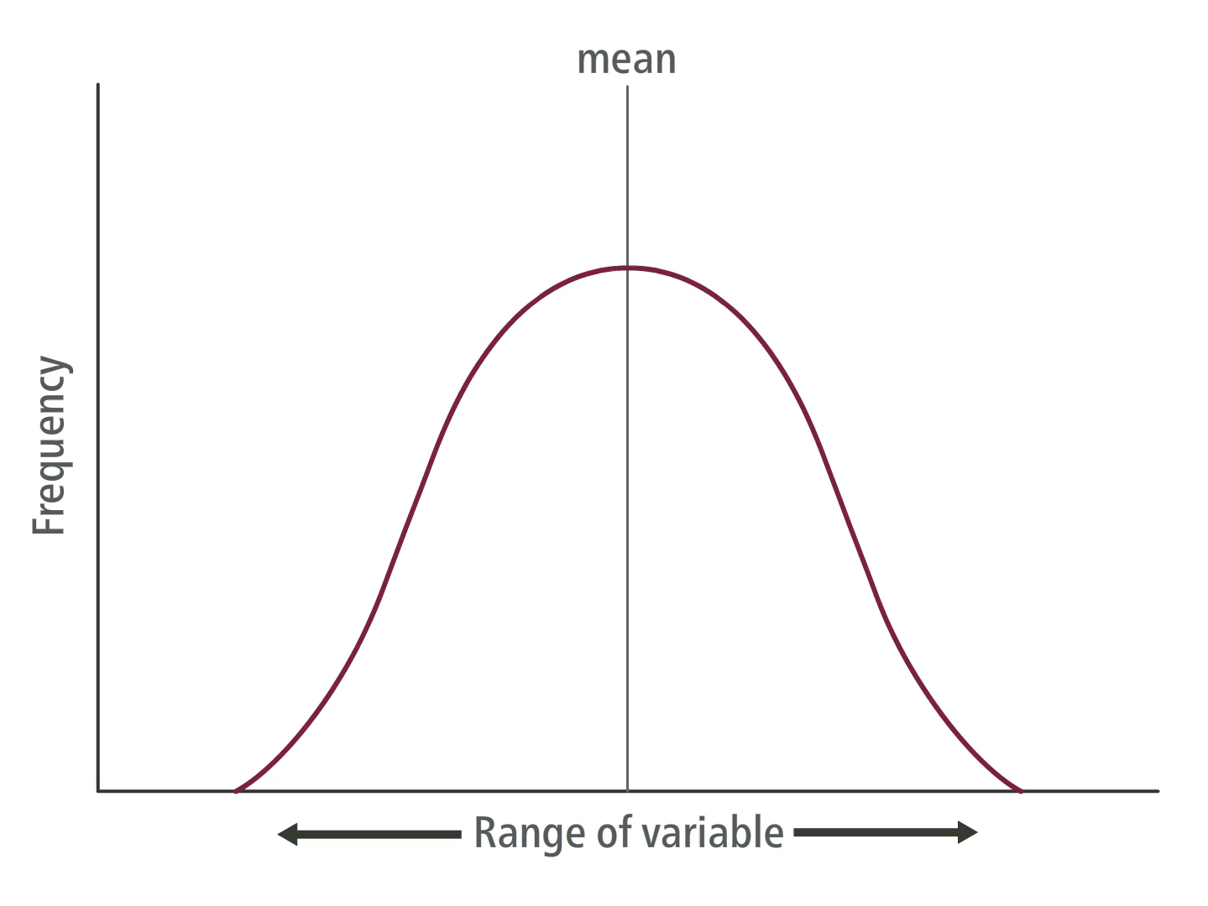
Unit 9 Lesson 1
Selection on Populations
Disruptive selection is the type of natural selection in which both extreme phenotypes are favored, while individuals with the intermediate phenotype are selected against.
Both extreme phenotypes are favored, while intermediate forms are selected against. By favoring both extreme phenotypes, disruptive selection can lead to the formation of new species.
Observe how disruptive selection affects the frequency of traits in a population.

Slide 17
Unit 9 Lesson 1
Selection on Populations
EXPLAIN
Using evidence from this lesson, explain why populations, not individuals, evolve.

Slide 18
Unit 9 Lesson 1
Effects of Gene Flow
Roses can grow in the wild or be cultivated. A bee may transport pollen from a farm that cultivates roses of different colors to a nearby area where wild red roses grow. The pollen can fertilize a wild rose flower, introducing new genetic material into the wild population.
This is an example of gene flow, which is the movement of alleles from one population to another. Gene flow can cause a population to evolve.
Explain how the difference in gene flow between populations could cause them to evolve in different or similar ways.

Slide 19

Effects of Gene Flow Hands-On Activity: Modeling Population Changes
Unit 9 Lesson 1
Use a deck of cards to represent the lizard population. The four suits represent four different alleles for tail shape. The allele frequencies of the original population are 25% spade, 25% heart, 25% club, and 25% diamond tail shapes.
How can random chance affect the allele frequencies in a population?

Slide 20
Unit 9 Lesson 1
Effects of Gene Flow
Genetic drift is a change in allele frequencies due to chance. For example, chance events such as natural disasters or birds dropping seeds on an island can change allele frequencies in a population.
Typically observed in small populations because small populations are more likely to be affected by chance.
The chance event causes some alleles to decrease in frequency, which may cause them to eventually disappear altogether.
Scientists have identified two processes that can cause population sizes to decrease enough for genetic drift to occur:
Bottleneck Effect
Founder Effect

Slide 21
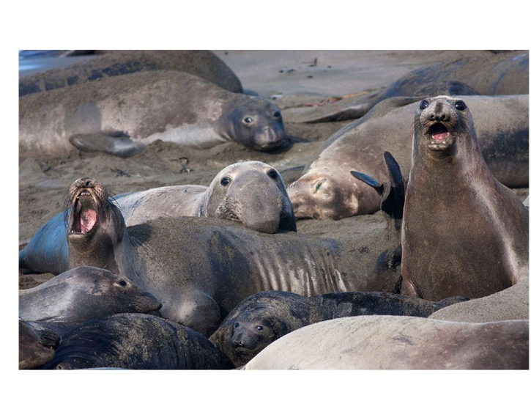
Unit 9 Lesson 1
Effects of Gene Flow
In the 1800s, northern elephant seals were overhunted for their blubber. By 1890, there were fewer than 100 individuals left.
After hunting ended, the population rebounded, and now there are more than 100,000 individuals.
The northern elephant seal suffered from the bottleneck effect. This is genetic drift resulting from an event that drastically reduces the size of a population.
The hunting of northern elephant seals greatly depleted the species' numbers and genetic diversity.

Slide 22
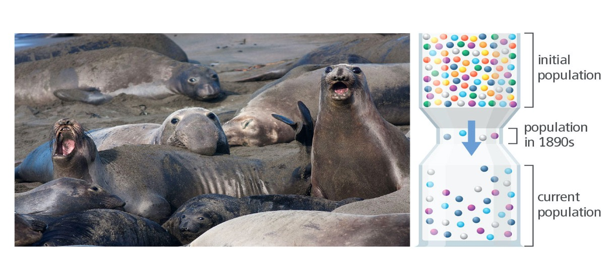
Unit 9 Lesson 1
Effects of Gene Flow
ANALYZE
Use the model to explain the change in genetic variation between the initial elephant seal population and the population after it rebounded.

Slide 23
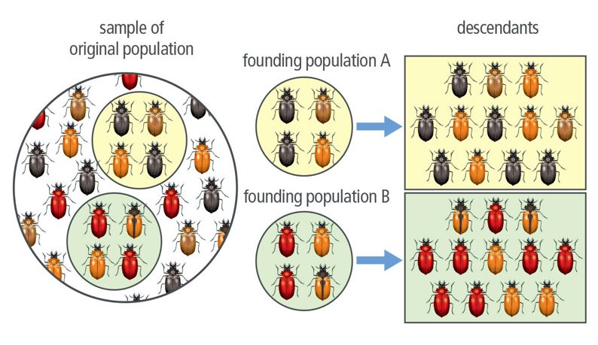
Unit 9 Lesson 1
Effects of Gene Flow
The founder effect is genetic drift that occurs when a small number of individuals become isolated from the original population and colonize a new area.
The founding populations each represent a distinct gene pool observed in the founding population.
As a result, allele frequencies within the founding populations change from the original population, reducing genetic variation.
Beetle Population Variation | Genetic variation decreases when a small number of individuals colonize new areas.

Slide 24
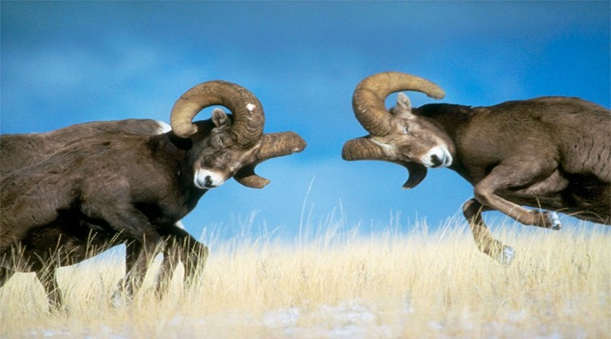
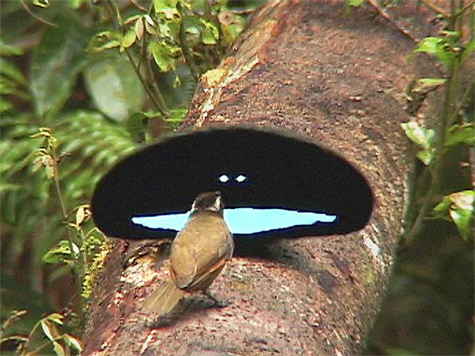
Unit 9 Lesson 1
Effects of Gene Flow
Sexual selection occurs when certain traits increase reproductive success.
Intrasexual selection is the competition between members of the same sex for a potential mate.
Intersexual selection occurs when males display certain traits that attract females.
COLLABORATE
With a partner, discuss what a female might learn about a male through his color, size, and ornamental features, such as bright tail feathers.
The winner of a fight increases his chances of mating with a female.
The male superb bird of paradise has bright feathers and large plumes to attract females.

Slide 25
Effects of Gene Flow Stability and Change
Unit 9 Lesson 1
MODEL
Draw a simple diagram to describe each of the mechanisms of evolution.
EXPLAIN
Why is genetic drift more likely in small populations than in large populations? Consider the male ruffs from the beginning of this lesson. How could genetic drift or sexual selection explain the different types of males in the population? Use evidence from the lesson to support your claims.

Slide 26
Unit 9 Lesson 1
Continue Your Exploration
Choose one of the paths below to continue your exploration:
Antibiotic-Resistant Bacteria
Examining Selection
Natural Selection in African Swallowtails
Runaway Selection

Slide 27
Can You Explain It?
Unit 9 Lesson 1
Refer to the notes in your Evidence Notebook to explain how three very different types of males evolved in a single population.

Slide 28
Image Credits
Unit 9 Lesson 1
male ruff bird ©Arco Images GmbH/C. Wermter/Alamy; meerkats ©EcoView/Fotolia; peppered moths ©Perennou Nuridsany/Science Source; penguins ©Digital Vision/Getty Images; elephant seals ©National Geographic Magazines/Marc Moritsch/Getty Images; rams fighting ©Corbis/W. Perry Conway/Getty Images; bird of paradise ©National Geographic Magazines/Tim Laman/Getty Images; male ruff satellite bird ©Matthijs Kuijpers/Alamy; female ruff bird ©Arco Images GmbH/C. Wermter/Alamy; meerkats ©EcoView/Fotolia; penguins ©Digital Vision/Getty Images; elephant seals ©National Geographic Magazines/Marc Moritsch/Getty Images; bird of paradise ©National Geographic Magazines/Tim Laman/Getty Images

